Slide 1
Pedagogical Effectiveness of Classroom Demonstrations Devices
Tom McCormick, Ph.D.
Dept. of Electrical & Computer Engineering
James C. Squire, P.E., Ph.D.
Dept. of Electrical & Computer Engineering
Gerald A. Sullivan, P.E., Ph.D.
Dept. of Mechanical Engineering
Virginia Military Institute

Slide 2
Demonstrations
Enhance student learning retention by providing greater intellectual simulation:
Retention improves from 20% to 50% with demonstration based lectures
Retention of up to 70% shown in students when demos are used
Significant gains in achievement scores has been documented

Slide 3
How should demonstrations be constructed for the best results?
Simple or complex?
Virtual or physical?
Build quality: raw or polished?

Slide 4
Prototype construction “raw”
Production-quality “polished”
?

Slide 5
Hypothesis:
Prototype-quality construction or (“raw”) demos improve retention as compared to production-quality (“polished”) construction and this improvement increases with academic maturity

Slide 6
Experiments:
Raw vs. Polished Hypothesis tested for two groups:
Freshmen
Sophomores
Each case assessed with respect to:
Objective comprehension
Self-assessed comprehension
Self-assessed enjoyment

Slide 7
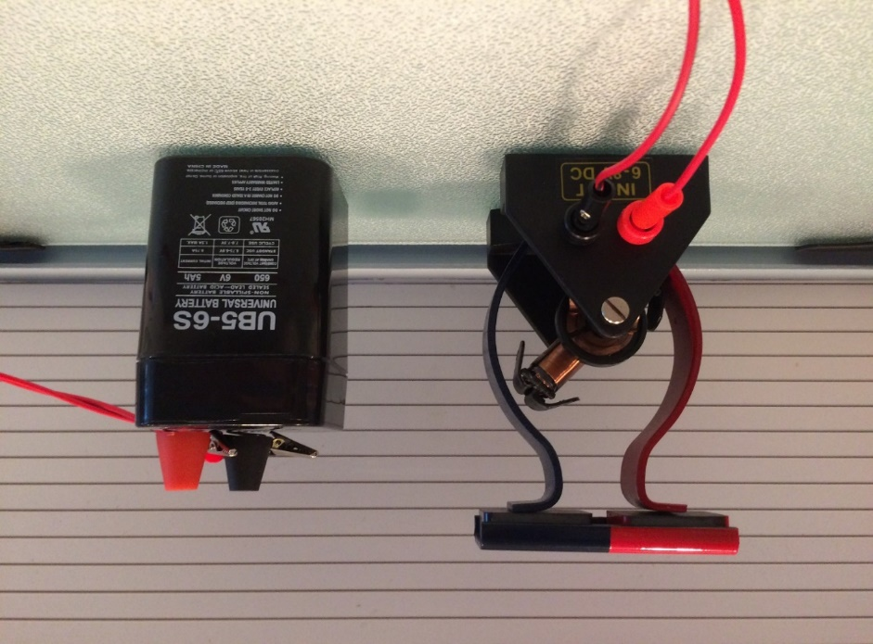
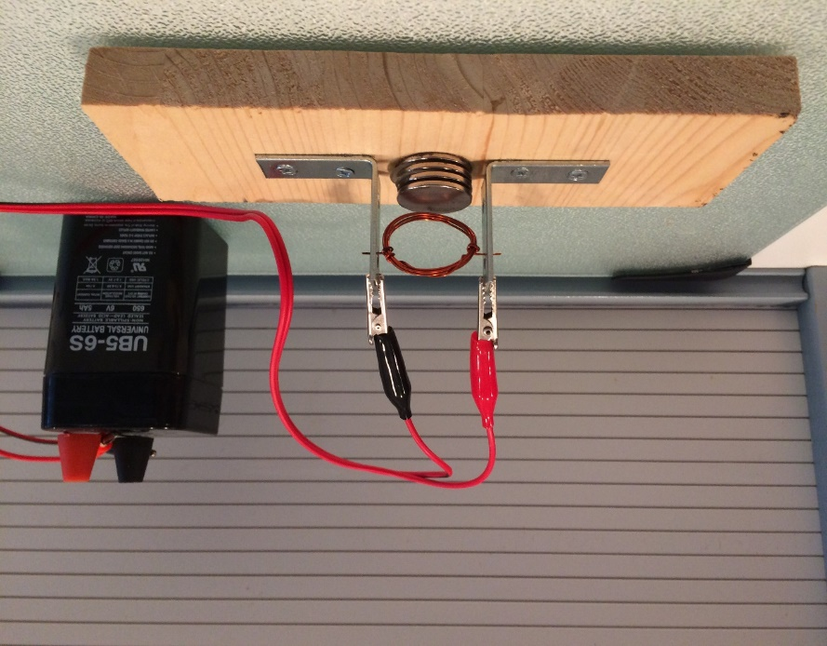
Electric Motor Demonstrators
Goal was to introduce concepts using a working model of an electric motor
Demos used during a lecture on motors:
polished
raw

Slide 8
Following lectures students took a 10 question multiple choice quiz that measured:
objective comprehension, for example:
subjective comprehension (“how well do you understand…”)
enjoyment (“how much did you enjoy today’s lesson?”)
10. The two main component of an electric motor are
a) Brushes and commutators
b) A commutator and a rotor
c) A rotor and a stator

Slide 9
A total of 127 students were involved in this case study:
Raw Demo | Polished Demo
63 students | 64 students

Slide 10
Results of 217 Trials
Construction
Technique:
0.91
0.89
0.9
Raw
Polished
0.80
0.80
0.8
0.7
0.66
0.59
0.6
Subjective
Enjoyment
Subjective
Comprehension
Objective
Comprehension

Slide 11
Hypothesis Testing Results
Two-tailed T-test showed:
Statistically significant difference in Objective Comprehension between the demos, p=.04
No Statistically significant difference in year groups, p=.19

Slide 12
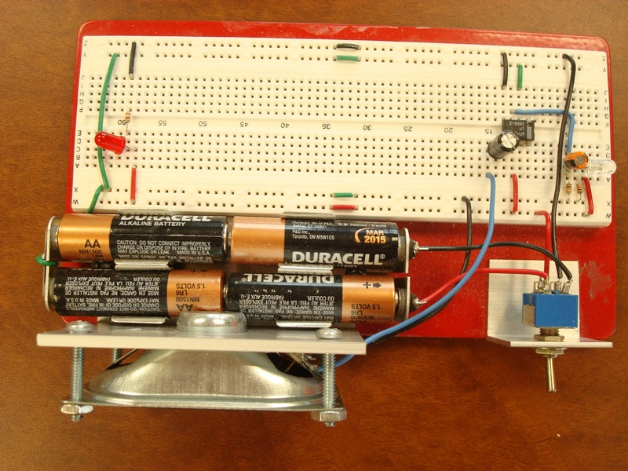
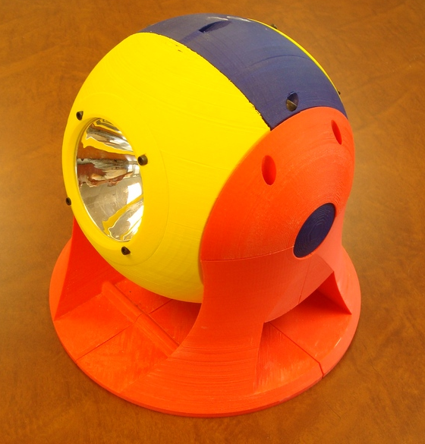
Case II: Laser Comm. Demo.
Goal was to introduce signal processing concepts using a “voice over Laser” communications system
Receiver system “Raw”
Receiver system “Polished”

Slide 13
Conclusions
The raw demonstration device was significantly better than the polished model (p < 0.05)
No conclusive difference found in objective comprehension between year groups
Subjective comprehension found to be a poor indicator of actual student learning

